Slide 1
Personality and Social
Randall C. O’Reilly

Slide 2
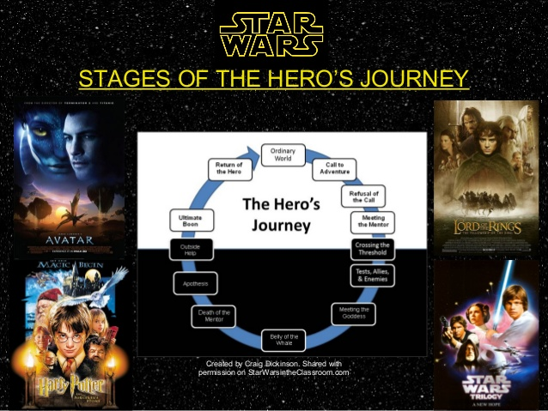
Adolescence / YA is all about finding your new identity, breaking with the comforts of family: plot of every movie!

Slide 3
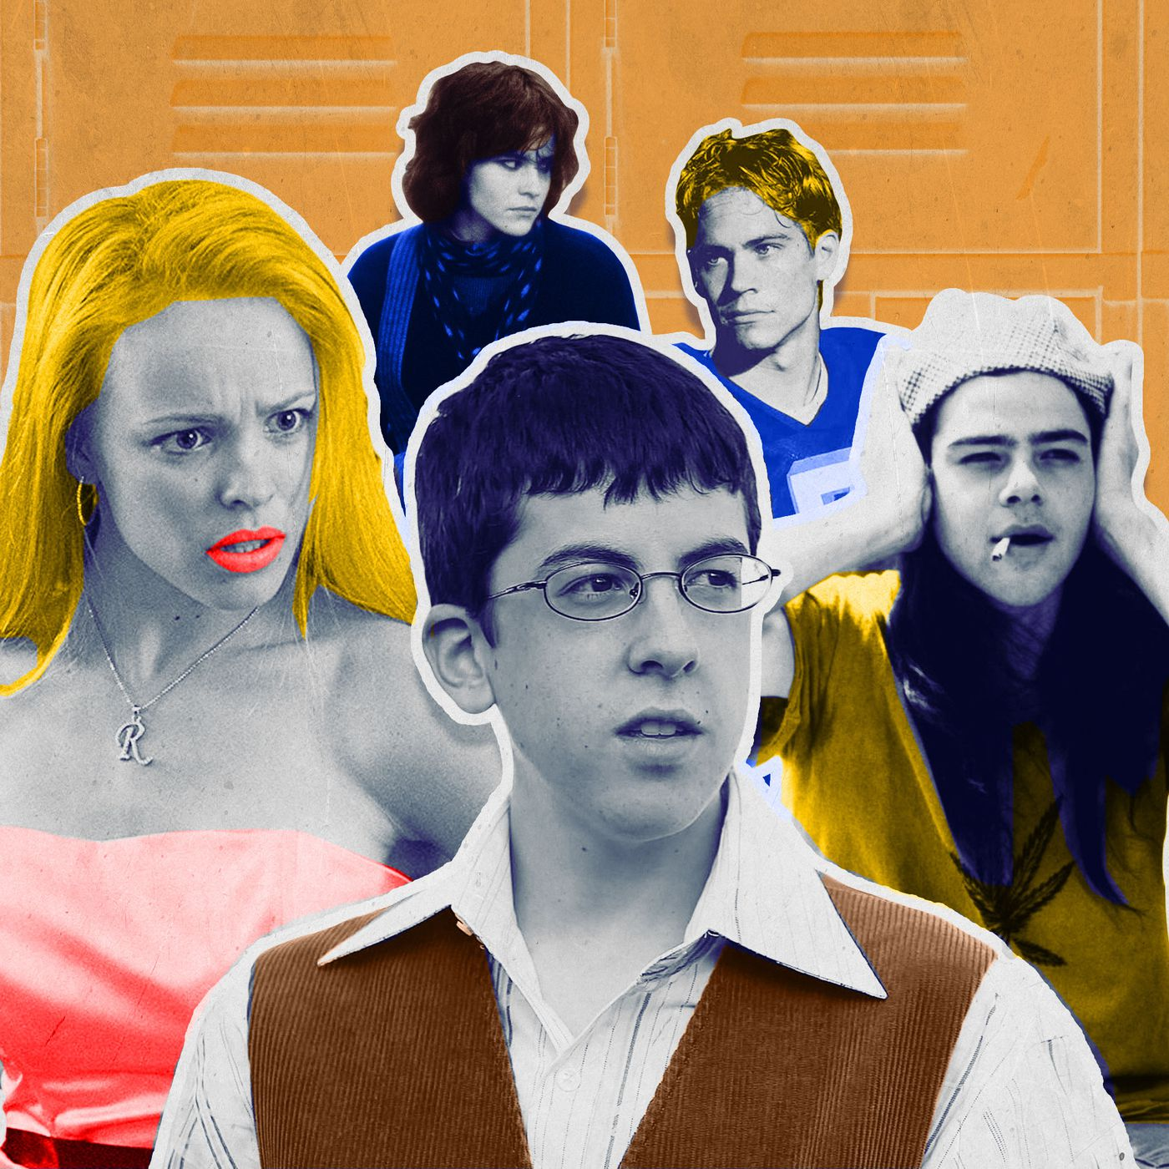
Find Your Social Identity
High school is a crucible / microcosm of our social brains at their most unhinged..
Social forces are strong
Dominant dimension:
“popularity” = social dominance in animal social groups
Also competence, warmth

Slide 4
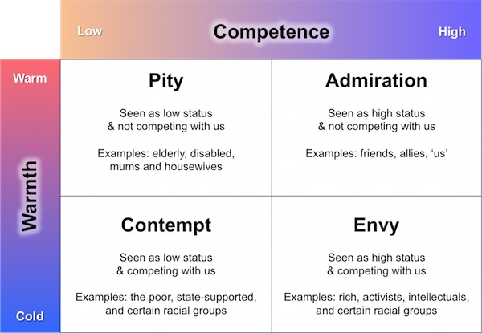
Dominant Dimensions
(many dimensions: intellectual, physical, social)
Popular / Preps
Stoners / Skaters etc
Geeks
Jocks
Losers / Outsiders
Mean Girls

Slide 5
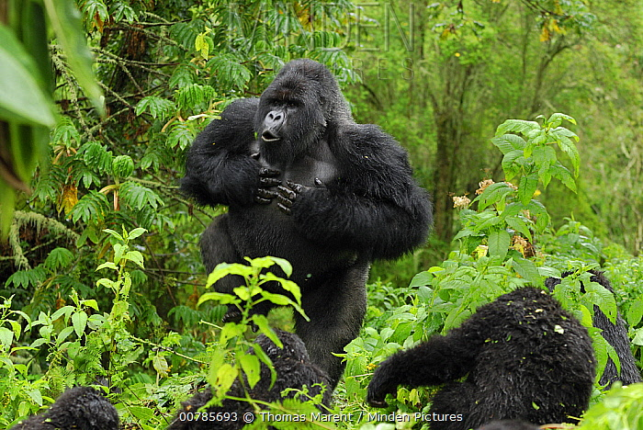
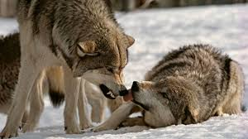
Animal Social Structure
Clear dominance hierarchy:
“Top Dog”, “Alpha Male”, etc.
Are people any different?
Chimpanzee Politics
by Franz de Waal

Slide 6
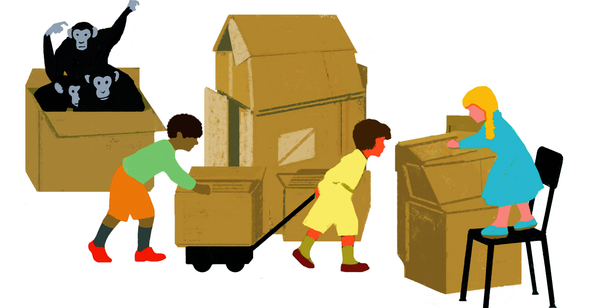
Social => Smart Humans
Robin Dunbar: Social brain hypothesis (complex!)
Michael Tomasello: Cooperation + Sharing
Geoffrey Miller: Showing off -> sexual selection

Slide 7
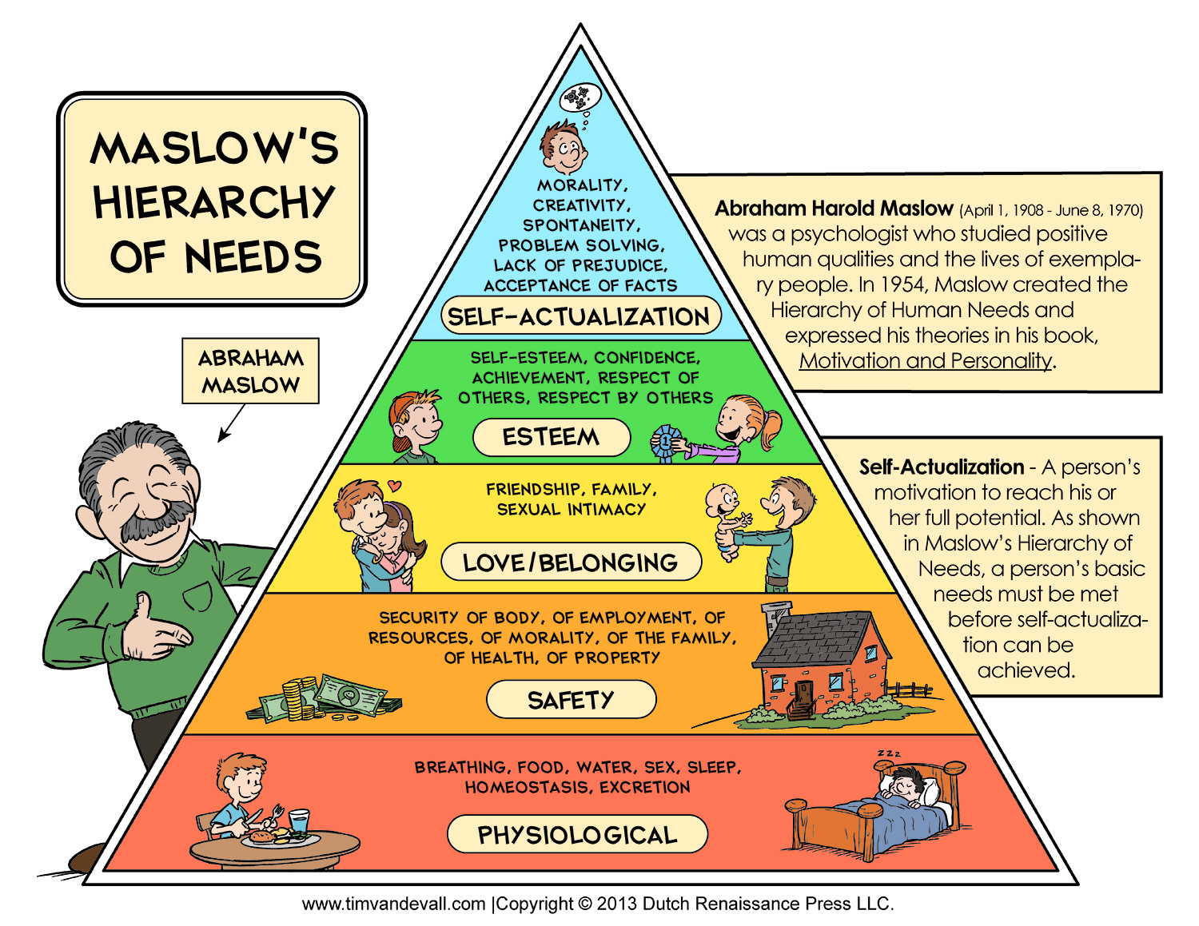
Ape Needs Stay at Bottom

Slide 8
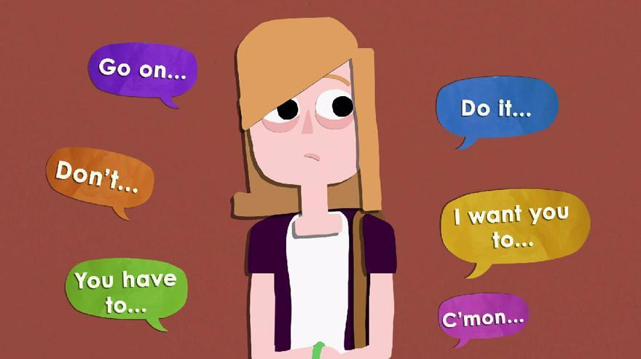
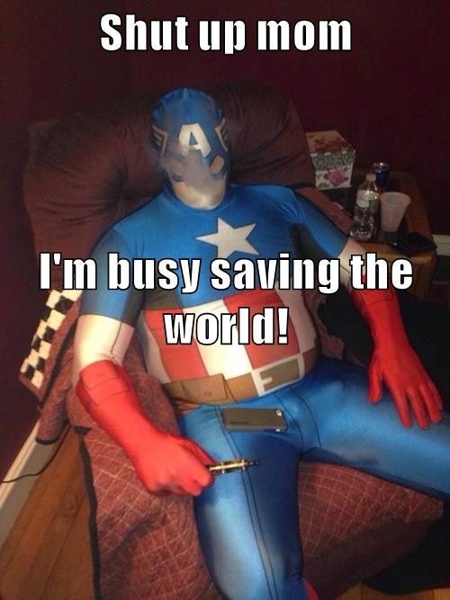
Individual vs. Social pressure
Social forces are so strong, we rebel against them, & fail to recognize their pervasive impact..
We want to be superheroes that save the world, not be dependent up it!

Slide 9
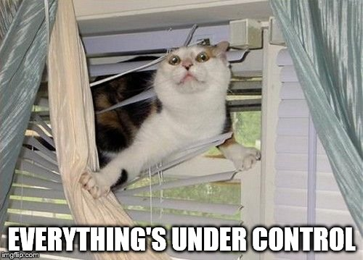
Subjective: Self is in Control!
Subjective experience dominated by sense that you are in control of your own self, not external social forces…
Self efficacy, self esteem: we’re all about the self!

Slide 10
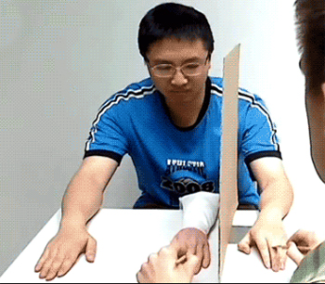
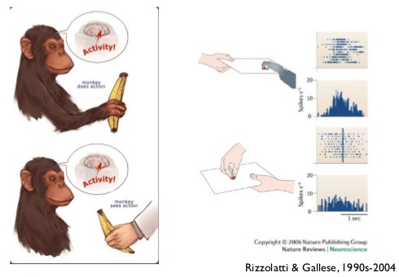
Self is a Predictive Model
Mirror neurons apply self model to others.
Constantly predicting multimodal sensory inputs:
* Physical self is central causal explanation for all those coincidences.
* Mental self explains behavior: we care a lot about explaining ourselves, and experience cognitive dissonance when it doesn’t add up!

Slide 11
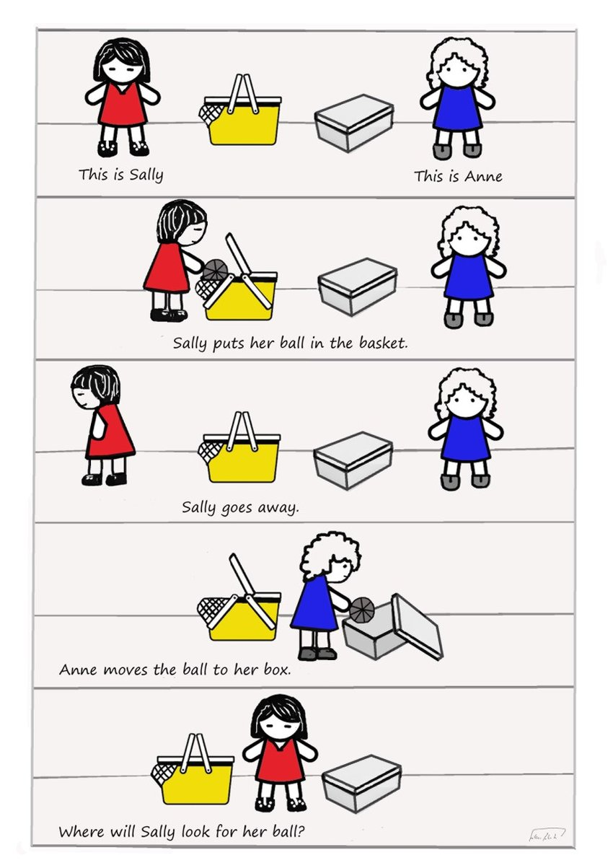
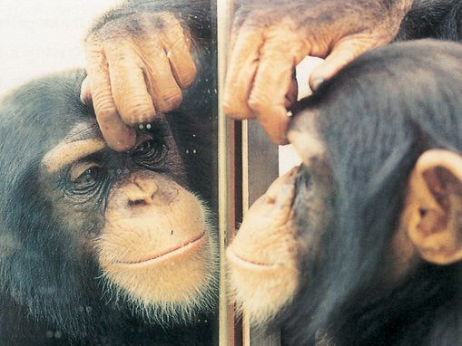
Self Awareness, Theory of Mind
Recognize self in a mirror?
Understand other experience != self experience

Slide 12
Self Phenomena
The best self-defense is a good offense:
Self-serving bias: overestimate contributions (I really do 75% of housework!), relative status (I’m definitely above average!), attribution errors (success = all me, failure = someone/thing else)
Positive illusions: it’s good to be delusional! uncritically positive views of self, illusions of control, unrealistic optimism: all CCC=Control!

Slide 13
Self – Other Attributions
Attribution theory: why do people do what they do? Is it them (disposition) or the situation?
Fundamental Attribution Error: attribute other’s behavior to them, ignoring situation.
Situation often invisible
But not so reliable cross-culturally, or in real adults..
And situation acts via dispositions in first place!

Slide 14
Actor-Observer Bias
When I cut someone off, I’m just late – when they do it, they’re just rotten jerks (always!)
Mainly happens for negative behaviors that we want to explain away via situation (but don’t have that motivation for others).

Slide 15
Control and Dissonance (Must stay in control, maintain self model)
Cognitive Dissonance: when behavior is at odds with beliefs / values / attitudes:
Change: 1. attitudes to match behavior, 2. behavior to match attitudes, or 3. perception of mismatch!
Cannot just let it go.. Must stay in control, always..
Often 1 or 3 – hard to change behavior, easier to “rationalize”
e.g., I am on diet; eat cookie anyway; reduce dissonance by minimizing (“only 1!”) or justifying (“I worked hard today”), etc.

Slide 16
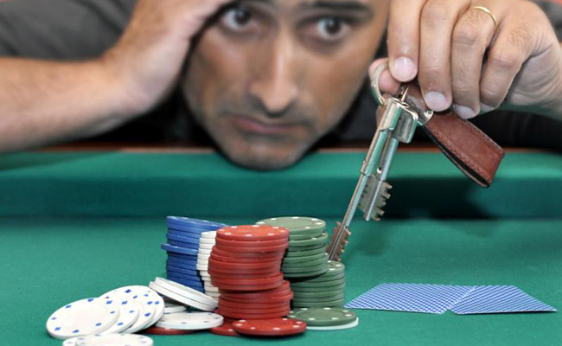
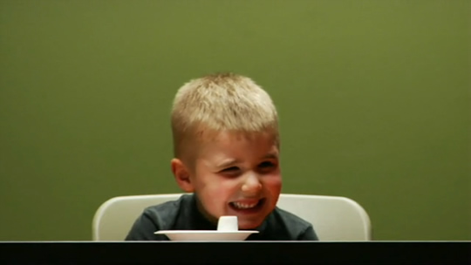
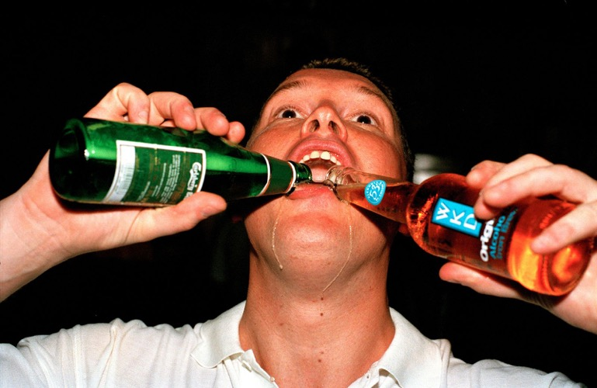
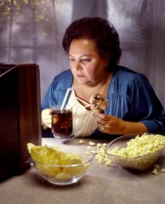
You struggle with Self Control

Slide 17
Self Control Summary
Self control: suppressing desires to be a better you, who is less dissonant with beliefs, values
Self regulation: All the processes of monitoring and controlling to achieve goals..
Marshmallow study (Mischel): behavior as a kid predicts many later life outcomes!
Depends on PFC executive function: so does a lot of other stuff (3rd variable: PFC is good, not self ctrl?)
Intertemporal choice: live for the moment, or save for the future!?

Slide 18
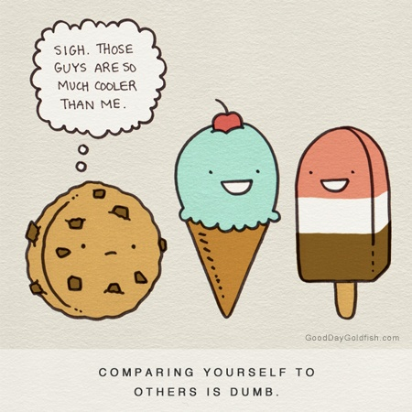
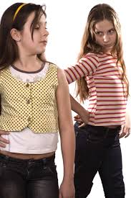

Social Comparison: Contrast!
All about establishing “dominance” hierarchy
Downward: make you feel better
Upward: inspiration

Slide 19
Shadenfreude
Someone else’s downfall is your upfall..

Slide 20
Impression Management
We constantly engage in active management of social impressions:
Produce positive / desired impressions
Reduce negative / un-desired impressions

Slide 21
Spotlight Effect
You think the whole world’s watching you / but they’re all just watching themselves!
I think this is a huge effect – and hugely important for your own personal well-being
Don’t worry about what others think of you – they’re too busy worrying about themselves!
Golden rule! Relax, be happy, etc.
OTOH, if you’re weird, people will talk about you and generally not want to socialize with you.

Slide 22
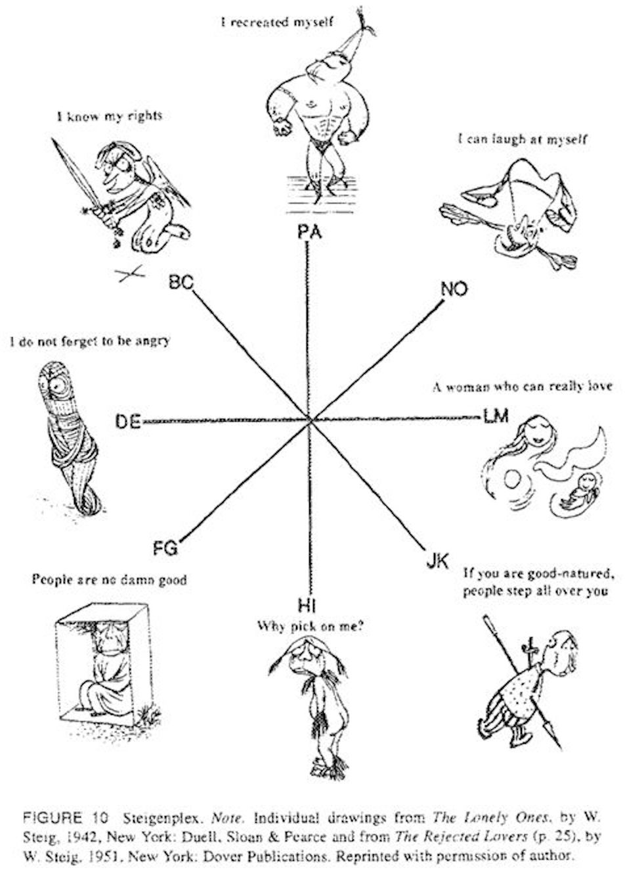
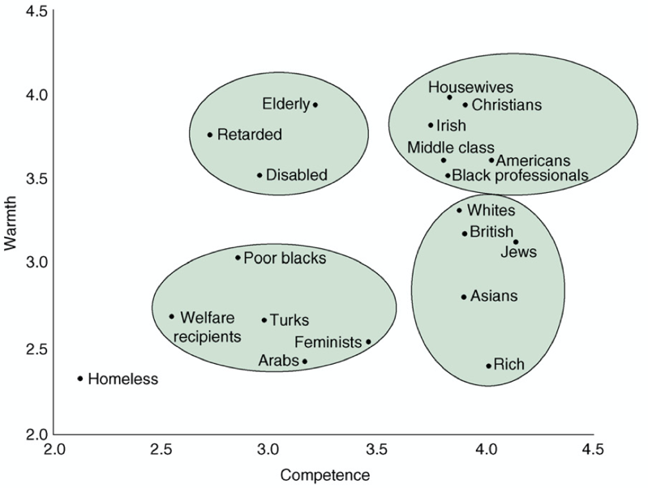
Interpersonal Situation: Personality in Social Interactions
Two dimensions:
Dominance / agency
Warmth / communion
Susan Fiske analysis of stereotypes:

Slide 23
Explanatory Style / Locus of Control
External locus of control: blaming others
* Loss of self-efficacy / control: learned helplessness
Internal locus of control: blaming self

Slide 24
Personality
Personality traits:
Organized
Integrated
Relatively Enduring
i.e., not just some random stuff you do..

Slide 25
Person-Situation Controversy
Does personality exist at all, or are we just a product of our situations??
Walter Mischel (1960’s): Situation is dominant
Seymour Epstein (1970’s): Need to integrate over multiple situations to see personality traits!
Trait-situation behavior model: both factors together determine behavior (the answer is always both!)
What if our behavior was so consistent that you could see personality in every action? Where is free will!?

Slide 26
The Big Five OCEAN
Openness
imaginative, curious, intellectual, creative.. Vs:
conventional and practical, enjoy routine, “down to earth”
Conscientiousness
careful, thorough, well-organized, responsible Vs:
careless, inefficient, disorganized, irresponsible
Extraversion*
Sociable, energetic, assertive, other-oriented Vs:
Passive, reserved, quiet, self-oriented
Agreeableness
Warm, kind, empathetic, compassionate, trusting Vs:
Hostile suspicious, unkind, lacking in trust..
Neuroticism*
Easily upset, anxious, emotional, self-pitying, worriers.. Vs:
Even-tempered, comfortable with selves, calm, stable.
Notes:
Do clicker quiz of class on each!!!

Slide 27
The Big Ten Facets (in Harry Potter)
Openness
Truth: intellectual (Ravenclaw)
Beauty: aesthetics (Luna Lovegood)
Conscientiousness
Industriousness: Hufflepuff
Orderliness: Ravenclaw
Extraversion*
Enthusiasm: Gryffindor
Assertiveness: Slytherin
Agreeableness
Compassion: Hufflepuff
Politeness: Slytherin
Neuroticism*
Volatility: active, angry, impulsive (Voldemort)
Withdrawal: depressive / anxious
Notes:
Do clicker quiz of class on each!!!

Slide 28
Eysenck Two Factors
Neuroticism and Extraversion – are these somehow more basic?

Slide 29
Approach vs. Avoid & Motivation Personality = emotion/motivation parameters
Approach orientation (BAS: activation):
Ideas: Openness
People: Extraversion
Avoid orientation (BIS: inhibition):
Generally: Neuroticism
People: Introversion, Ideas: -Openness
Anger = Agreeableness
Organization drive = Conscientiousness

Slide 30
Big Five Issues
Seem clearly distinct in general desirability: there is a “good” side and a “bad” side to each
Why has evolution preserved all these “bad” personalities? What is actually “good” about them?
Strong social orientation: mostly about how we interact with others

Slide 31
Genetics and Change
As usual, about 50% contribution of genetics to personality factors (parents know this!)
Traits get more stable over time
Biggest change is in young adulthood (you!)
Rank-order stability: how do their factors rank over time? Measures patterns within individuals. More stable
Mean-level stability: does overall population level of trait change over time? Less stable.

Slide 32
Gender Differences
Women higher in neuroticism, extraversion, agreeableness, conscientiousness

Slide 33
Measurement Techniques
NEO-PI: high face validity, only useful for normal diagnosis
MMPI: Minnesota Multiphasic Personality Inventory: objective (scored by computer)
Low in face validity, but useful for abnormal diagnosis
TAT, Rorschach: highly subjective, not used..
Low validity, low reliability

Slide 34
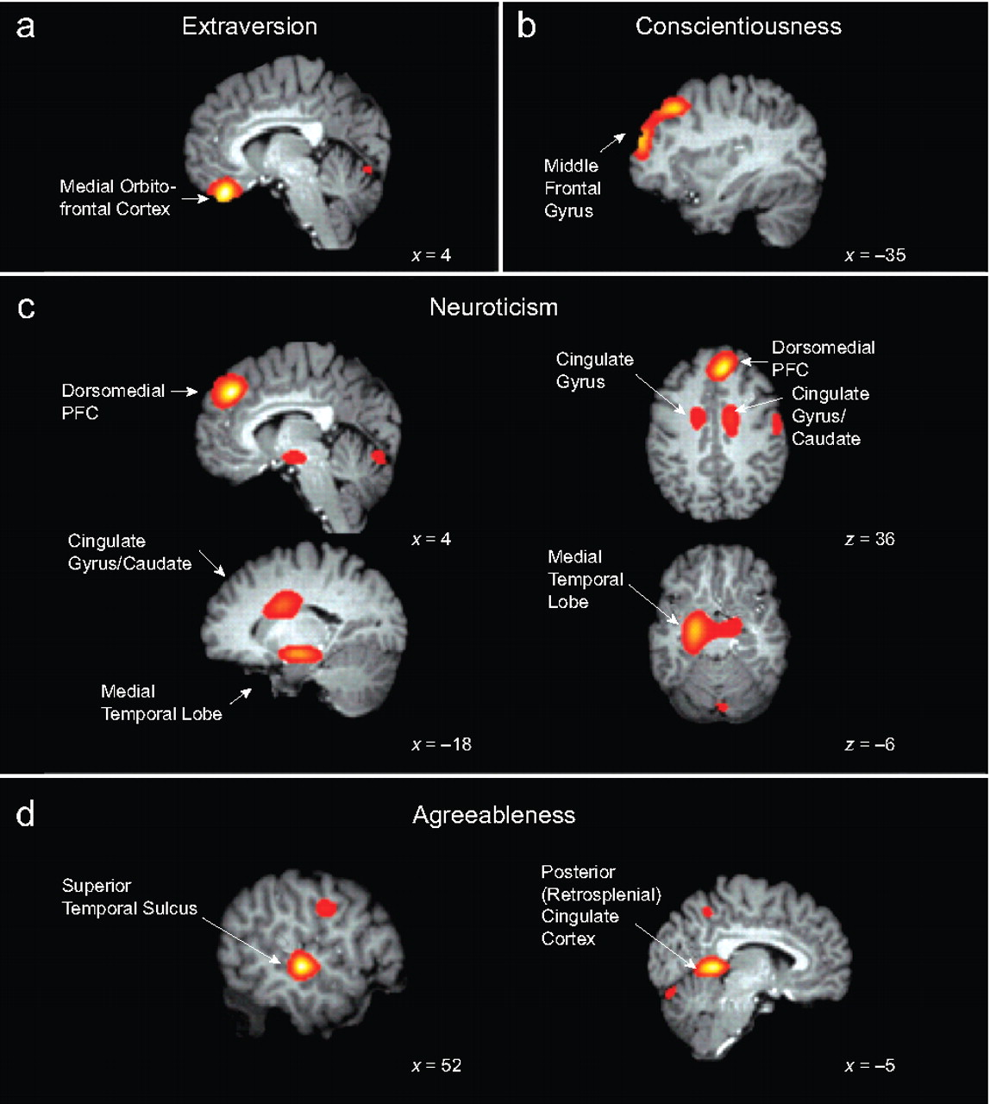

Slide 35
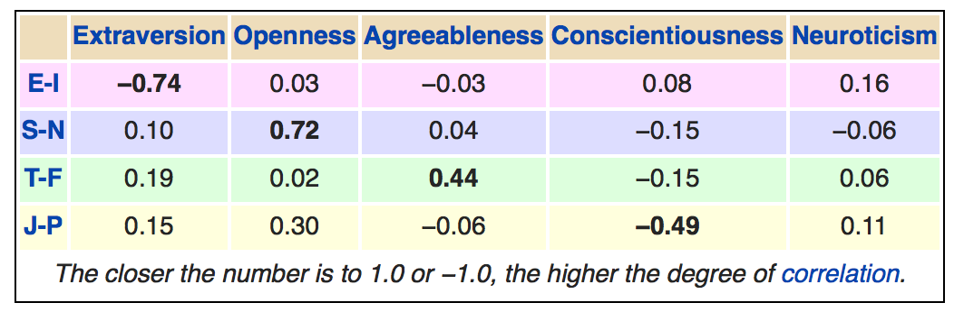
Meyers-Briggs?

Slide 36
Social Groups
Going beyond the individual / self <-> social into the world of emergent social dynamics in groups.

Slide 37
In-Group, Out-Group
We (presumably) evolved in small “tribes” that had to compete with others for limited resources.
Tribes that helped (love) members and killed (hate) non-members were more successful..
This happens with Chimps:
And all the time in humans
Can we be one big tribe??

Slide 38
Selfish Genes and Inclusive Fitness
Genes are selfish: they can live forever – we are just temporary hosts! (The great chain of being: genes passed down over millions of years!)
You share tons of genes with relatives – even distant ones (we are all distant cousins)..
We are motivated to help each other: Altruism = inclusive fitness of the group!

Slide 39
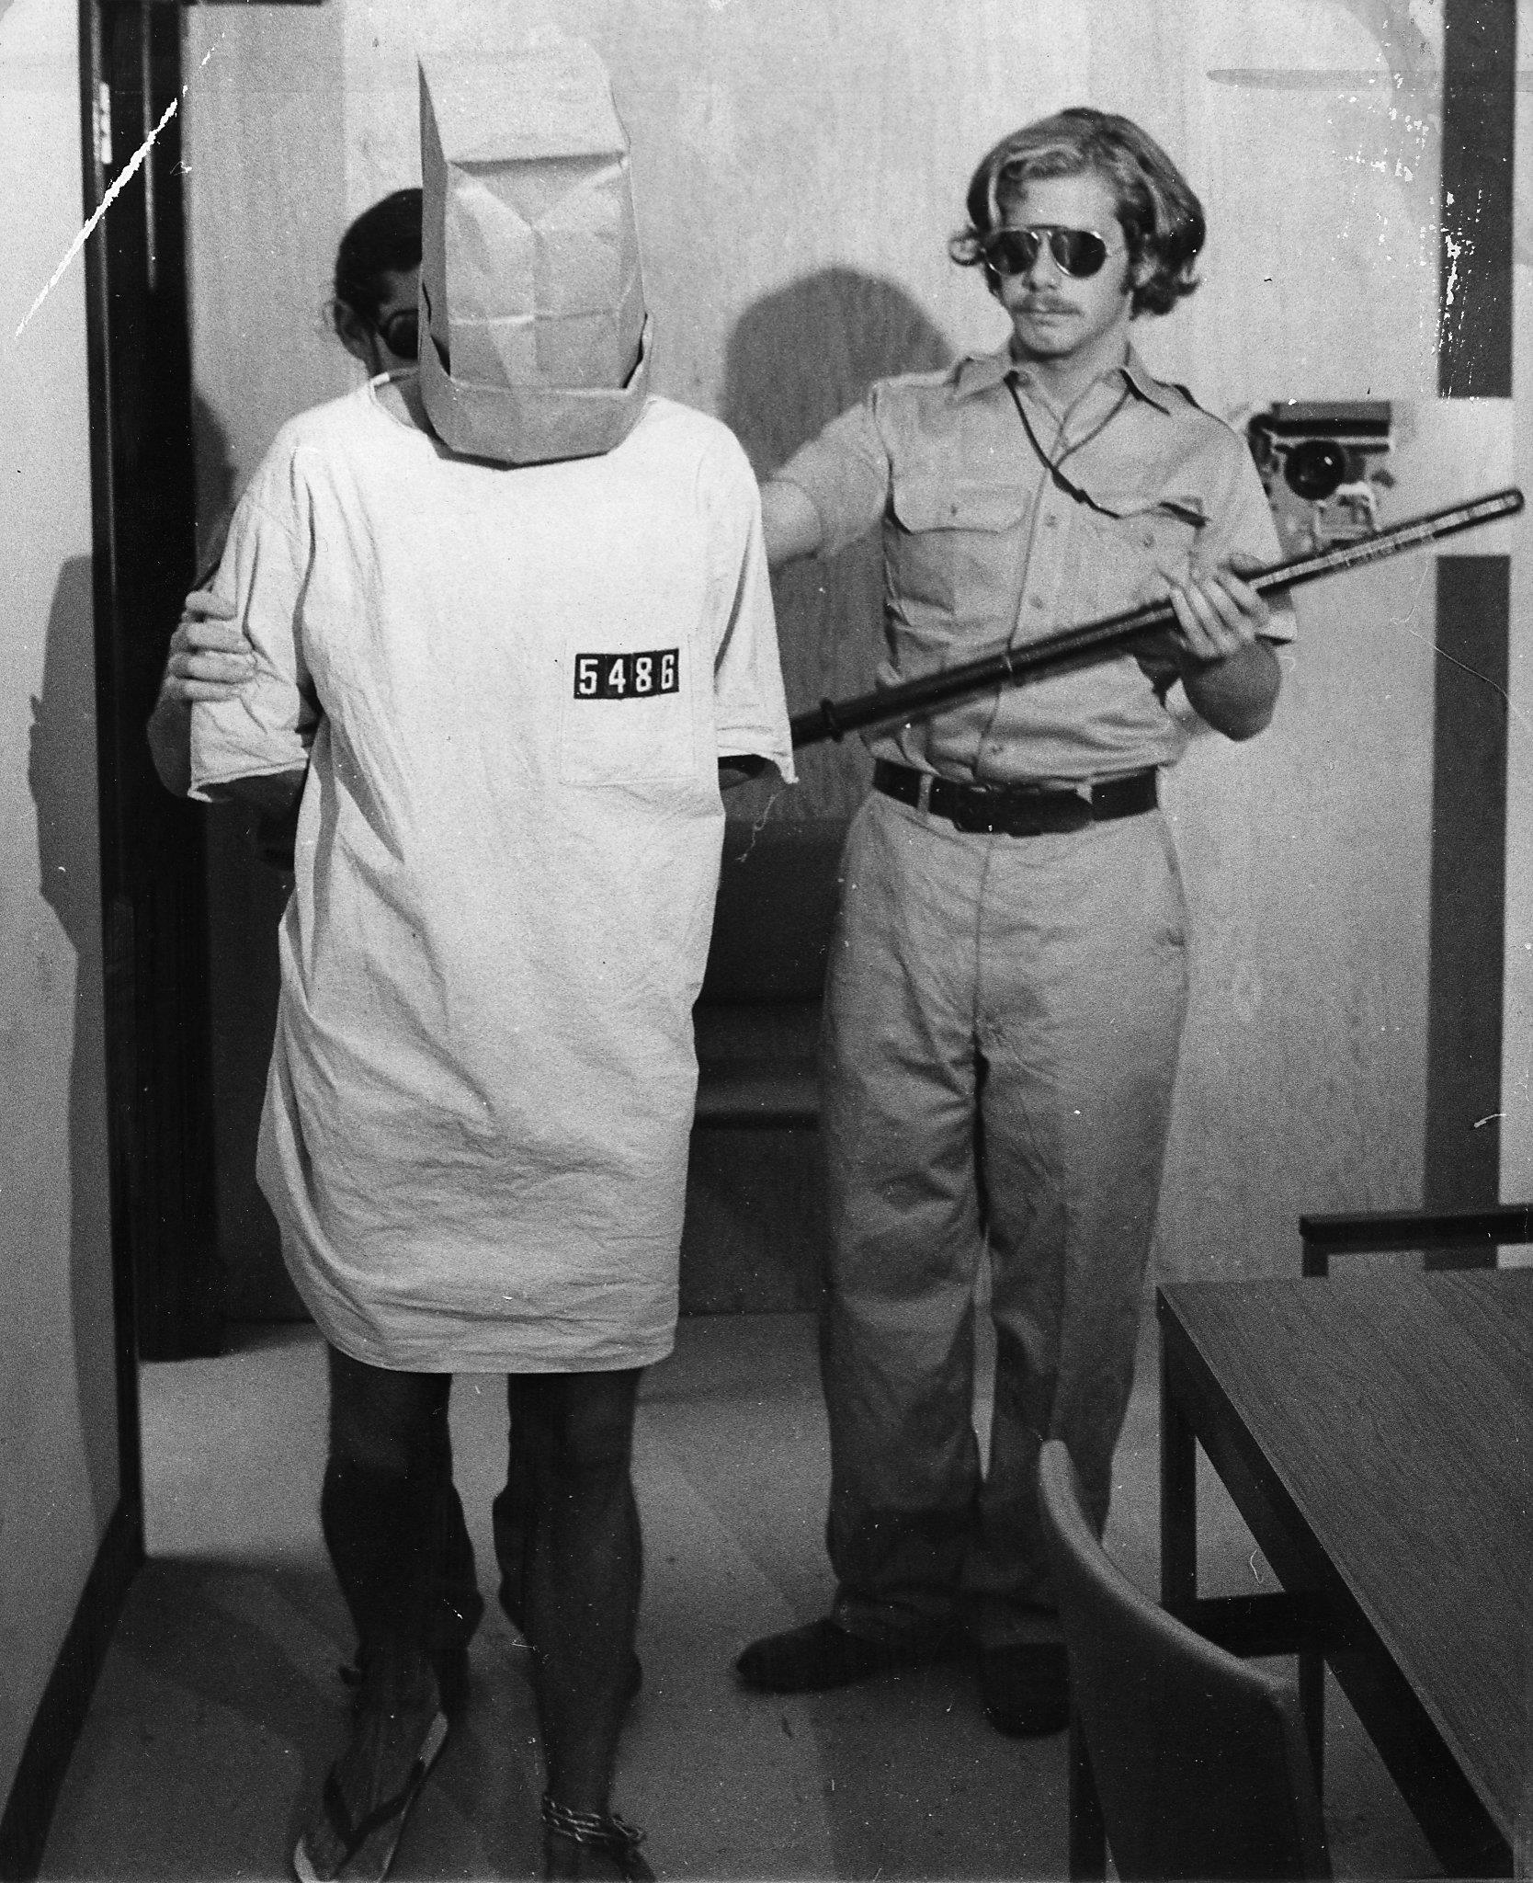
Stanford Prison Experiment etc
Innocent college kids become evil prison guards!
But some coaching from Zimbardo and others running expt.
Robbers Cave (Sherif et al, 1961) (Lord-of-the-flies behavior from kids) also had some issues.
Not easy to capture true evil in experimental context, but no doubt about its prevalence in real world!

Slide 40
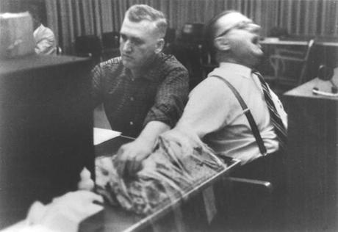
Milgram Experiment
People “shocked” a confederate to point of unconsciousness!
Unclear what they really believed.
Illustrates “following orders” of authority figure (experimenter)

Slide 41
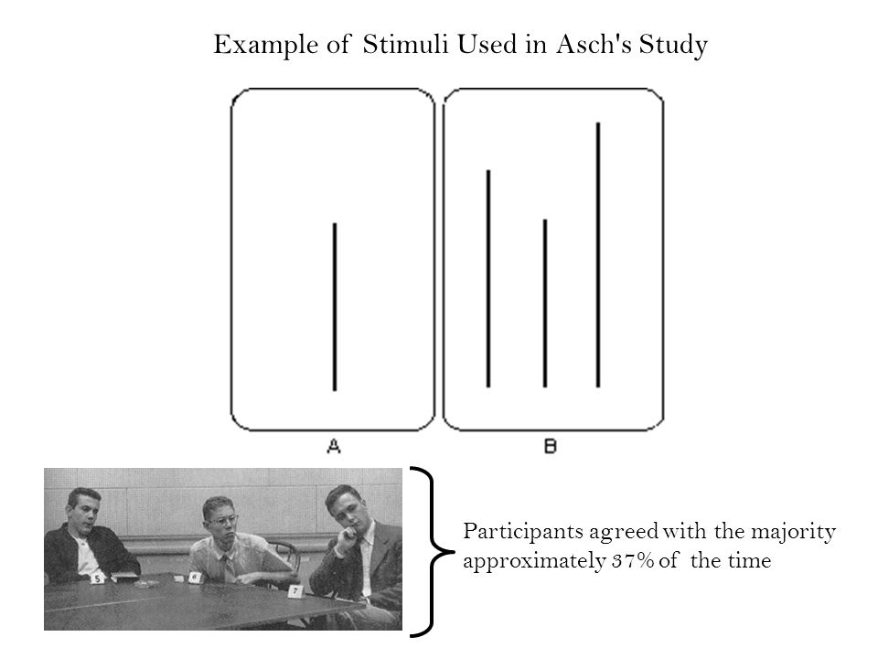
Conformity: Social Pressure
Solomon Asch:
Brains wired for
social approval
But 95% did deviate
at least once
Groupthink: collective failure to consider what could go wrong.. Bay of Pigs, Iraq War..

Slide 42
Bystander Effect: Kitty Genovese
Legend: nobody helped despite screams (diffusion of responsibility: someone else will call the cops..)
Truth: several people called police. Police were very slow to respond.
Initial reporting “told a story”
in biased manner.
(Killer just died in prison)

Slide 43
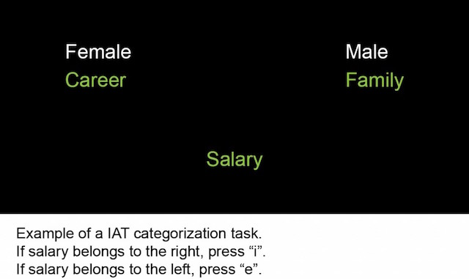
Stereotyping, Prejudice
Stereotyping: typical features of given group – erroneously assumed to apply to all members of group. CCCC = Compression / Categorize
Prejudice: pre-judging according to stereotypes
often implicit (IAT):

Slide 44
CCC = The 3 C’s
CCC = Compression, Contrast, Control
Compression: filtering, simplifying, capturing the essence while removing the noise (perception, memory, learning, stereotypes, delusions..)
Contrast: everything is relative (happiness, color, size, income, social standing..)
Control: we are each little despots ruling our own fiefdoms, and don’t you ever diss me! (control is central to most mental disorders)

Slide 45
Sociocultural Psychology
Opposite of evolutionary: culture is a major shaping force of behavior, values, etc
Major dimensions:
Individualism vs. collectivism: USA vs. Asia
Power distance (acceptance of power diffs): Scandanavia low, Asian, Arab, Latin Am. high
Masculinity / Femininity: Japan male, Sweden fem.
Uncertainty avoidance: Japan high, USA low
Social role: how do you fit in (e.g., patriarchy)
Notes:
Masculinity/Feminity: Men to be assertive, dominant, competitive women to nurture. Feminine- overlapping roles for the sexes, dominant values = caring for others
Uncertainity: Tolerance for uncertainty/ambiguity: Highly predictable, prescribed ways of doing thing; USA- acceptance for new ideas

Slide 46
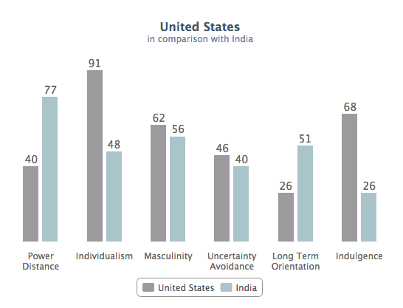
Help with cross-cultural interactions!
Notes:
http://geert-hofstede.com/united-states.html

Slide 47
Self Enhancement CCC = Control!
Conclusion: everyone is focused on self enhancement – cultural universal – but form it takes depends on cultural norms..
Westerners: self-enhance on individualistic elements
East Asian cultures: self-enhance on collectivistic element
Self enhancement – make people feel good about themselves, enhance self esteem
Notes:
Control & motivation are primarily positively oriented- want to control our thoughts/behaviors to get positive outcomes & self enhancement is a reflection of that

